Slide 1
BIKE DEMAND PRESENTATION
Dennis Lam 4 JUNE 2021

Slide 2
EXECUTIVE SUMMARY
Bike demands are influenced by cities, available bicycles for rent, seasons, temperature, hour of the day and holidays
Linear regression model is recommended to predict bike demand

Slide 3
Introduction
Project is about how weather would affect bike-sharing demand in urban areas
Data collection and sources
Data exploration and analysis
Data wrangling
Data modelling
Interactive Dashboard
conclusion

Slide 4
methodology
Web scraping from Wikipedia (global bike sharing systems)
5 day weather forecasts for cities using openweather api
Perform data wrangling on csv files
Perform data exploration
Perform data visualisation
Predict Hourly Rented Bike Count using Basic Linear Regression Models
Refine the Baseline Regression Models

Slide 5
Exploratory data analysis
Dataset has 8465 observations for seoul
Date range is from 1 dec 2017 to 30 Nov 2018 (one year)
Highest bike count is 3556 on 19 June 2018
Summer has most bike rentals, winter the least
Demand varies from city to city

Slide 6
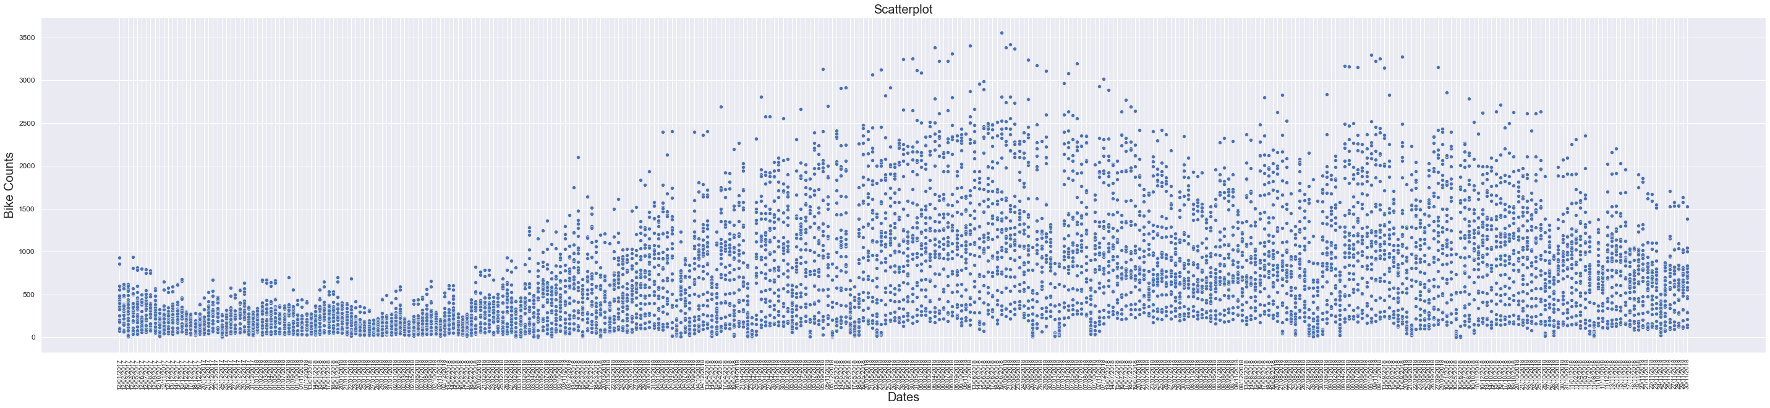
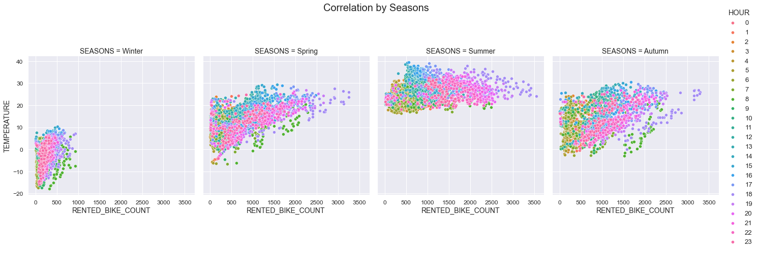
data visualization

Slide 7
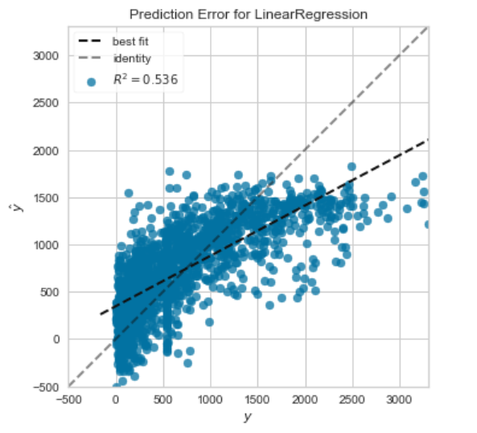
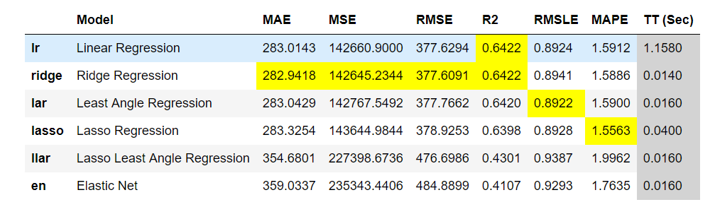
Predictive analysis
baseline regression model
improving the model

Slide 8
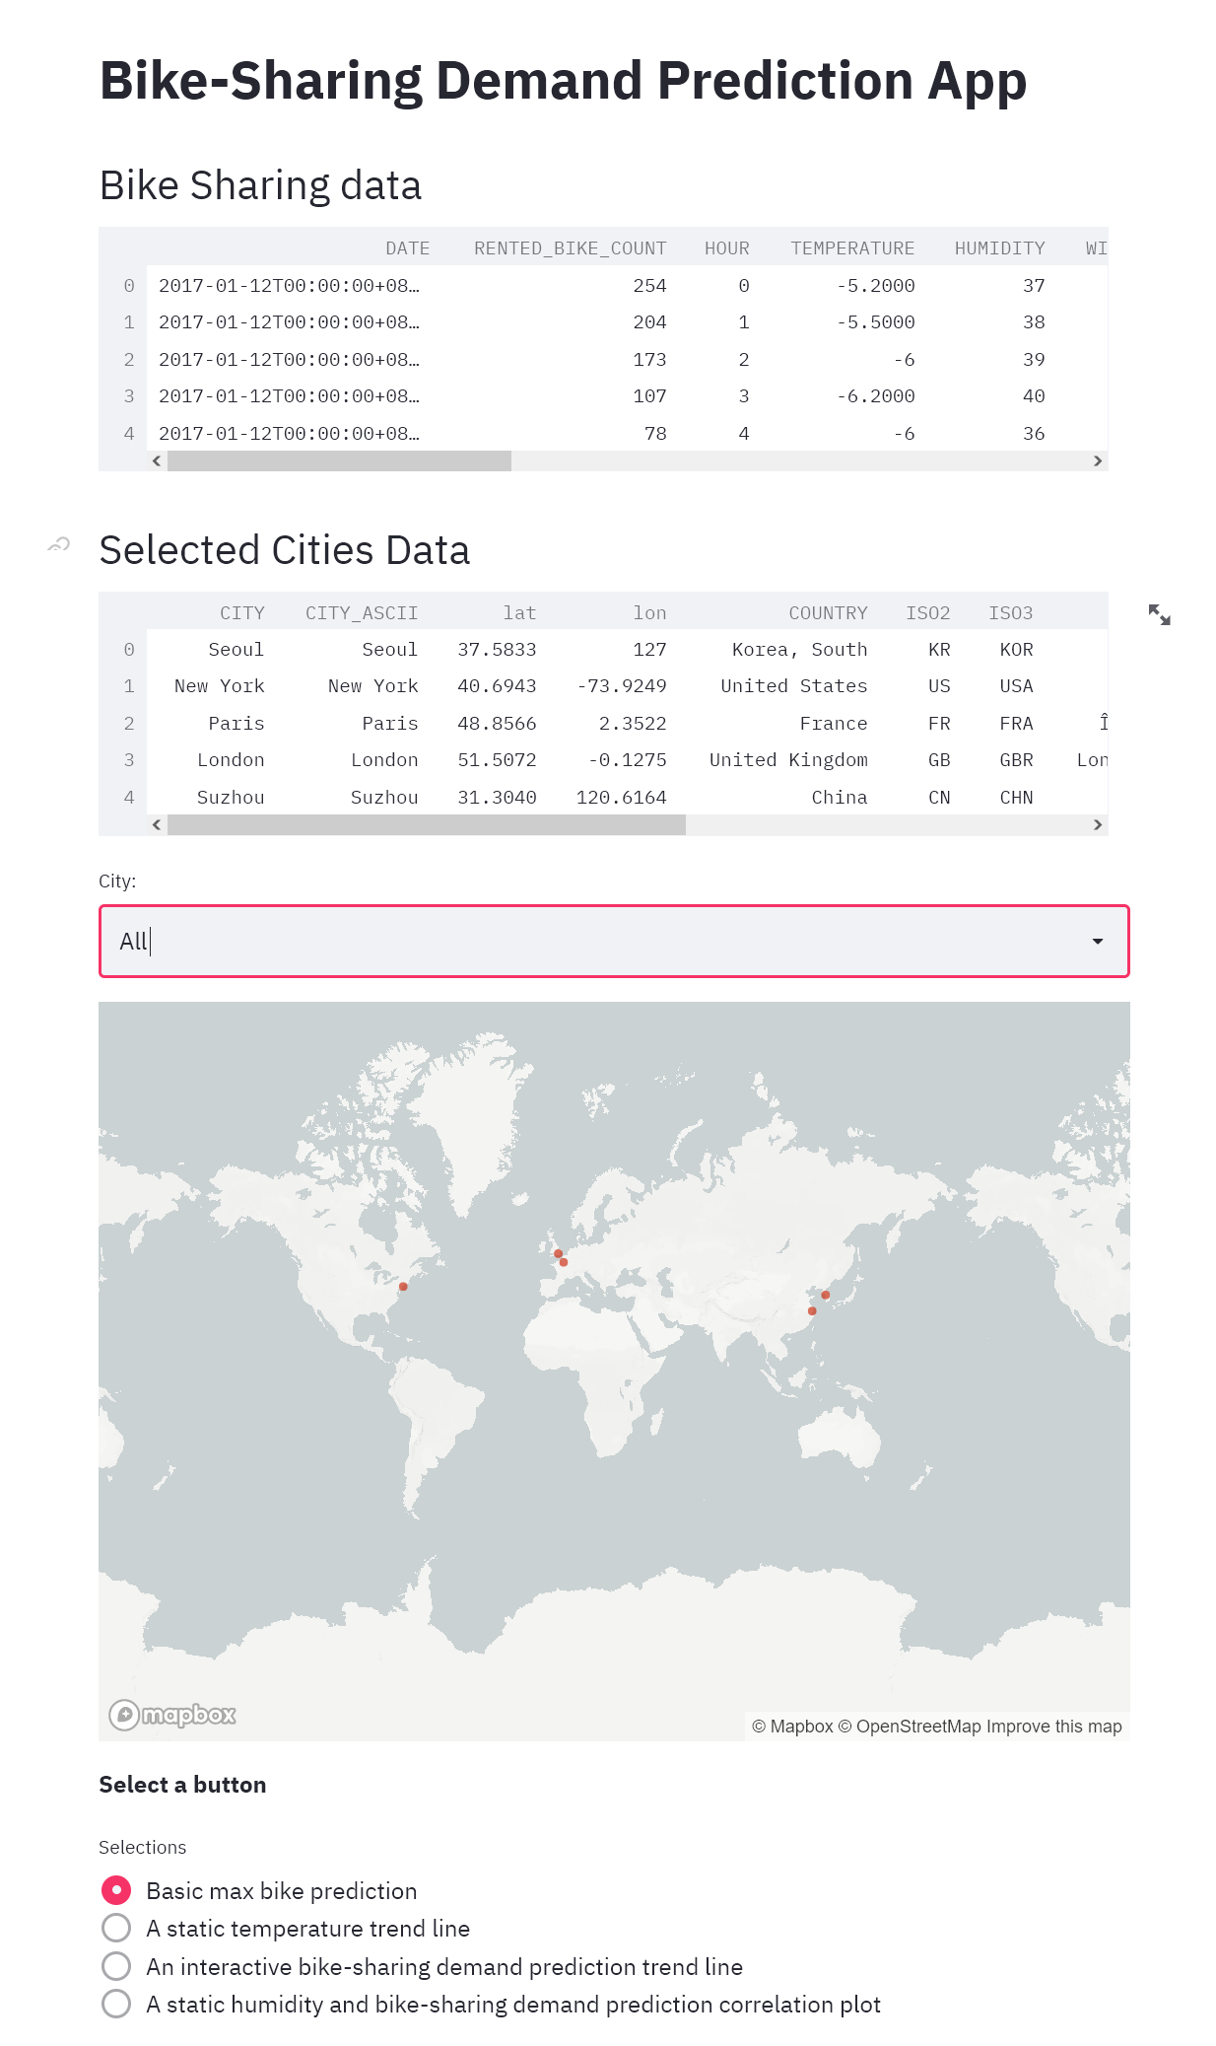
Interactive Dashboard

Slide 9
conclusion
Bike demands are influenced by cities, available bicycles for rent, seasons, temperature, hour of the day and holidays
Linear regression model is recommended to predict bike demand
Explore more sources on bikes demand online for analysis
Use machine learning algorithms (decision tree, random forest, xgboost, gradient boost)
Potential use for marketing and business expansions

Slide 10
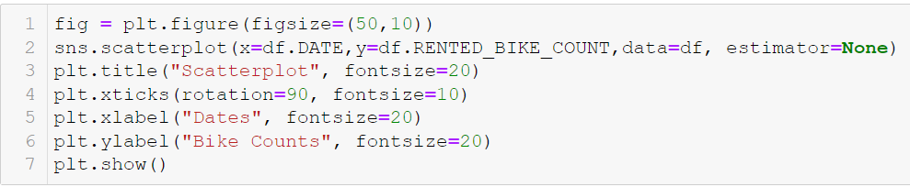
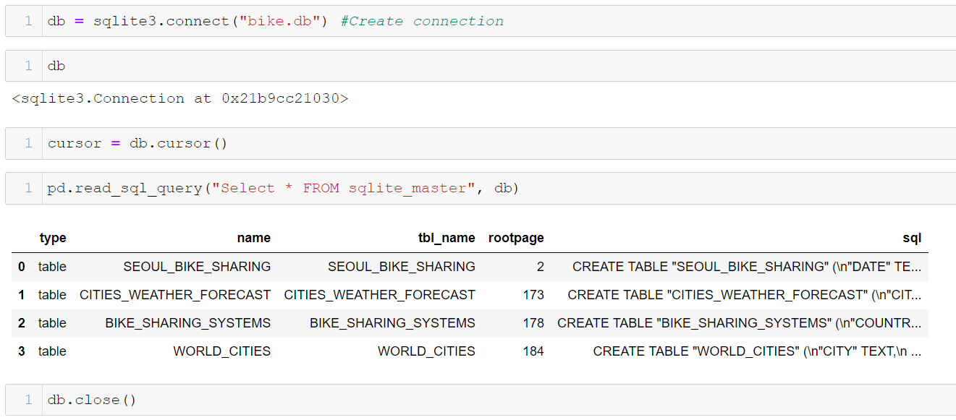
appendix
Python code sample
Sql code sample

